Slide 1
Polygon Clipping
Notes:
Utah School of Computing
Spring 06
Computer Graphics CS5600

Slide 2
Ex: Simple Convex
09/02/13 11/07/26
Prepared by Narendra V G CSE MIT
Notes:
Utah School of Computing
Spring 06
Computer Graphics CS5600

Slide 3
Ex: Multiple Components
09/02/13 11/07/26
Prepared by Narendra V G CSE MIT
Notes:
Utah School of Computing
Spring 06
Computer Graphics CS5600

Slide 4
Nonconvex with Many Edges
09/02/13 11/07/26
Prepared by Narendra V G CSE MIT
Notes:
Utah School of Computing
Spring 06
Computer Graphics CS5600

Slide 5
Polygons : Before Clipping
09/02/13 11/07/26
Prepared by Narendra V G CSE MIT
Notes:
Utah School of Computing
Spring 06
Computer Graphics CS5600

Slide 6
Polygons: Clip on Top
Top Clip
Boundary
09/02/13 11/07/26
Prepared by Narendra V G CSE MIT
Notes:
Utah School of Computing
Spring 06
Computer Graphics CS5600

Slide 7
Polygons: Clip on Right
Right Clip
Boundary
09/02/13 11/07/26
Prepared by Narendra V G CSE MIT
Notes:
Utah School of Computing
Spring 06
Computer Graphics CS5600

Slide 8
Polygons: Clip on Bottom
Bottom Clip
Boundary
09/02/13 11/07/26
Prepared by Narendra V G CSE MIT
Notes:
Utah School of Computing
Spring 06
Computer Graphics CS5600

Slide 9
Polygons: Clip on Left
Left Clip
Boundary
09/02/13 11/07/26
Prepared by Narendra V G CSE MIT
Notes:
Utah School of Computing
Spring 06
Computer Graphics CS5600

Slide 10
Polygons: Clipped Polygon
09/02/13 11/07/26
Prepared by Narendra V G CSE MIT
Notes:
Utah School of Computing
Spring 06
Computer Graphics CS5600

Slide 11
Hodgeman-Sutherland
Notes:
Utah School of Computing
Spring 06
Computer Graphics CS5600

Slide 12
Polygons: Case 1
IN
OUT
S
Polygon
being
clipped
P: output
Clip
boundary
09/02/13 11/07/26
Prepared by Narendra V G CSE MIT
Notes:
Utah School of Computing
Spring 06
Computer Graphics CS5600

Slide 13
Case 1: S & P both IN
Action: Output P
Notes:
Utah School of Computing
Spring 06
Computer Graphics CS5600

Slide 14
Polygons: Case 2
IN
OUT
P
S
i output
09/02/13 11/07/26
Prepared by Narendra V G CSE MIT
Notes:
Utah School of Computing
Spring 06
Computer Graphics CS5600

Slide 15
Case 2: S IN; P OUT
Action: Output i
(S was already output under Case 1)
Notes:
Utah School of Computing
Spring 06
Computer Graphics CS5600

Slide 16
Polygons: Case 3
IN
OUT
P
S
(no output)
09/02/13 11/07/26
Prepared by Narendra V G CSE MIT
Notes:
Utah School of Computing
Spring 06
Computer Graphics CS5600

Slide 17
Case 3: S & P both OUT
Action: None
Notes:
Utah School of Computing
Spring 06
Computer Graphics CS5600

Slide 18
Polygons: Case 4
P: second
output
IN
OUT
S
i: first output
09/02/13 11/07/26
Prepared by Narendra V G CSE MIT
Notes:
Utah School of Computing
Spring 06
Computer Graphics CS5600

Slide 19
Case 4: S OUT; P IN
Action: Output i and P
Notes:
Utah School of Computing
Spring 06
Computer Graphics CS5600

Slide 20
Case 1: S & P both IN
Case 2: S IN; P OUT
Action: Output P
Action: Output i
(S already output
under Case 1)
Case 4: S OUT; P IN
Case 3: S & P both OUT
Action: None
Action: Output i and P
09/02/13 11/07/26
Prepared by Narendra V G CSE MIT
Notes:
Utah School of Computing
Spring 06
Computer Graphics CS5600

Slide 21
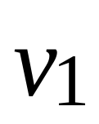
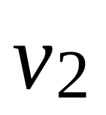
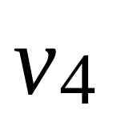
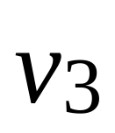
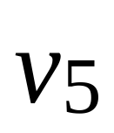
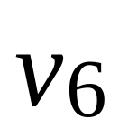
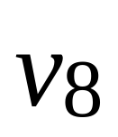
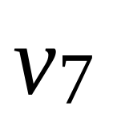
Hodgeman-Sutherland
09/02/13 11/07/26
Prepared by Narendra V G CSE MIT
Notes:
Utah School of Computing
Spring 06
Computer Graphics CS5600

Slide 22
Hodgeman-Sutherland
09/02/13 11/07/26
Prepared by Narendra V G CSE MIT
Notes:
Utah School of Computing
Spring 06
Computer Graphics CS5600

Slide 23
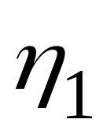
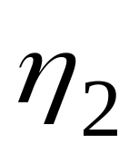
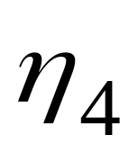
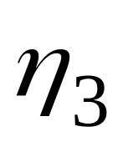
Hodgeman-Sutherland: Top
09/02/13 11/07/26
Prepared by Narendra V G CSE MIT
Notes:
Utah School of Computing
Spring 06
Computer Graphics CS5600

Slide 24
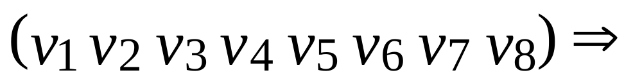
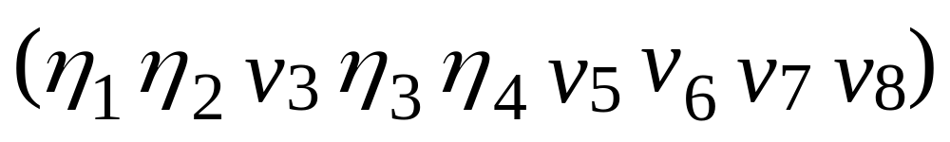
Hodgeman-Sutherland: Top
09/02/13 11/07/26
Prepared by Narendra V G CSE MIT
Notes:
Utah School of Computing
Spring 06
Computer Graphics CS5600

Slide 25
Hodgeman-Sutherland: Bottom
09/02/13 11/07/26
Prepared by Narendra V G CSE MIT
Notes:
Utah School of Computing
Spring 06
Computer Graphics CS5600

Slide 26
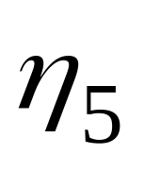
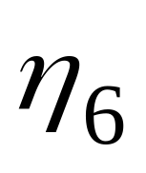
Hodgeman-Sutherland: Bottom
09/02/13 11/07/26
Prepared by Narendra V G CSE MIT
Notes:
Utah School of Computing
Spring 06
Computer Graphics CS5600

Slide 27
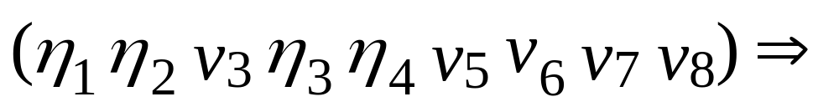
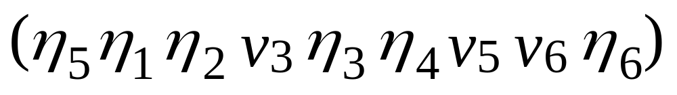
Hodgeman-Sutherland: Bottom
09/02/13 11/07/26
Prepared by Narendra V G CSE MIT
Notes:
Utah School of Computing
Spring 06
Computer Graphics CS5600

Slide 28
Hodgeman-Sutherland: Right
09/02/13 11/07/26
Prepared by Narendra V G CSE MIT
Notes:
Utah School of Computing
Spring 06
Computer Graphics CS5600

Slide 29
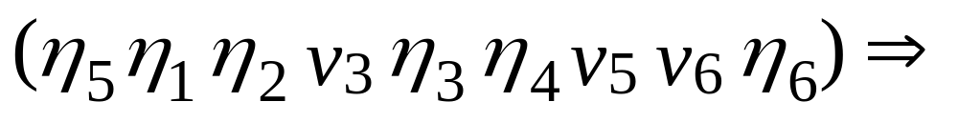
Hodgeman-Sutherland: Right
This case is trivial: do nothing
09/02/13 11/07/26
Prepared by Narendra V G CSE MIT
Notes:
Utah School of Computing
Spring 06
Computer Graphics CS5600

Slide 30
Hodgeman-Sutherland: Left
09/02/13 11/07/26
Prepared by Narendra V G CSE MIT
Notes:
Utah School of Computing
Spring 06
Computer Graphics CS5600

Slide 31
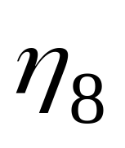
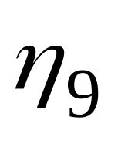
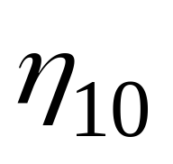
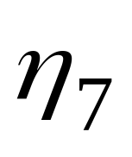
Hodgeman-Sutherland: Left
09/02/13 11/07/26
Prepared by Narendra V G CSE MIT
Notes:
Utah School of Computing
Spring 06
Computer Graphics CS5600

Slide 32
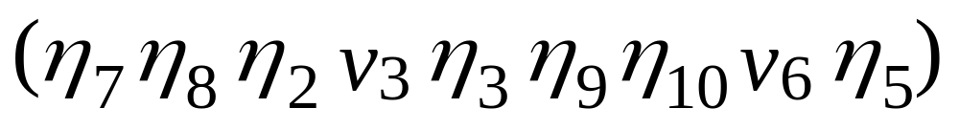
Hodgeman-Sutherland: Left
09/02/13 11/07/26
Prepared by Narendra V G CSE MIT
Notes:
Utah School of Computing
Spring 06
Computer Graphics CS5600

Slide 33
Hodgeman-Sutherland: Done
09/02/13 11/07/26
Prepared by Narendra V G CSE MIT
Notes:
Utah School of Computing
Spring 06
Computer Graphics CS5600

Slide 34
Hodgeman-Sutherland: Done
09/02/13 11/07/26
Prepared by Narendra V G CSE MIT
Notes:
Utah School of Computing
Spring 06
Computer Graphics CS5600

Slide 35
Correct Result
How to Fix Up?
09/02/13 11/07/26
Prepared by Narendra V G CSE MIT
Notes:
Utah School of Computing
Spring 06
Computer Graphics CS5600

Slide 36
Distinguish Between Case 2
IN
OUT
P
S
i output
09/02/13 11/07/26
Prepared by Narendra V G CSE MIT
Notes:
Utah School of Computing
Spring 06
Computer Graphics CS5600

Slide 37
And, Case 4
IN
OUT
P: second
output
S
i: first output
09/02/13 11/07/26
Prepared by Narendra V G CSE MIT
Notes:
Utah School of Computing
Spring 06
Computer Graphics CS5600

Slide 38

Distingish Between Case 2
IN
OUT
P
S
09/02/13 11/07/26
Prepared by Narendra V G CSE MIT
Notes:
Utah School of Computing
Spring 06
Computer Graphics CS5600

Slide 39

And, Case 4
P: second
output
IN
OUT
S
09/02/13 11/07/26
Prepared by Narendra V G CSE MIT
Notes:
Utah School of Computing
Spring 06
Computer Graphics CS5600

Slide 40
The End
Polygon Clipping
Notes:
Utah School of Computing
Spring 06
Computer Graphics CS5600

